Slide 1
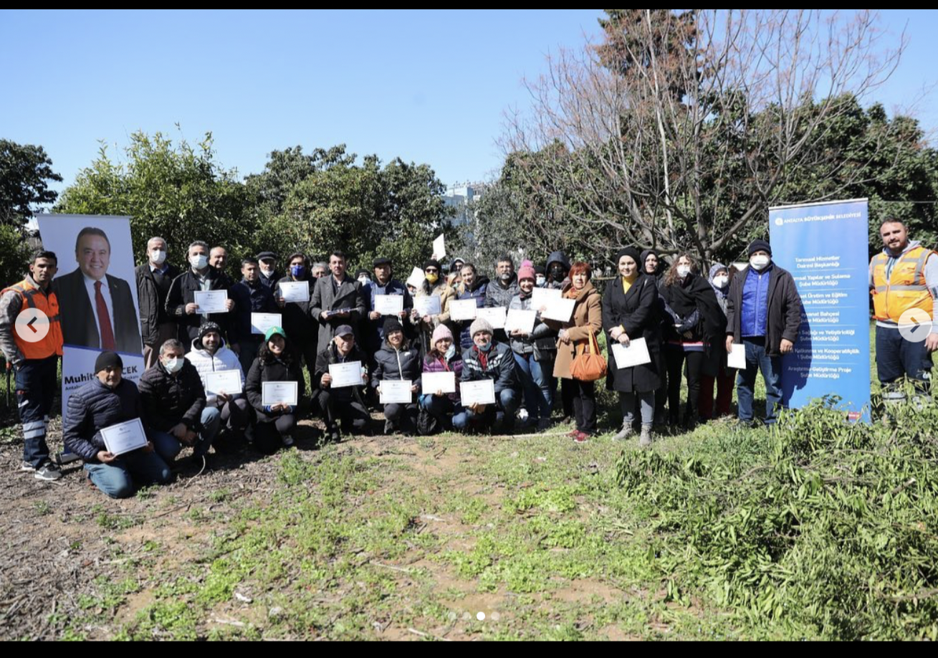
ANTALYA SUPPORTS SUSTAINABLE AGRICULTURE
Our municipality gives opportunity to the producers and farmers to practice tree pruning and grafting.
Producers and farmers are trained by agricultural engineers without any charge.
Antalya municipality stands by the producers with trainings to increase productivity in sustainable agriculture.

Slide 2
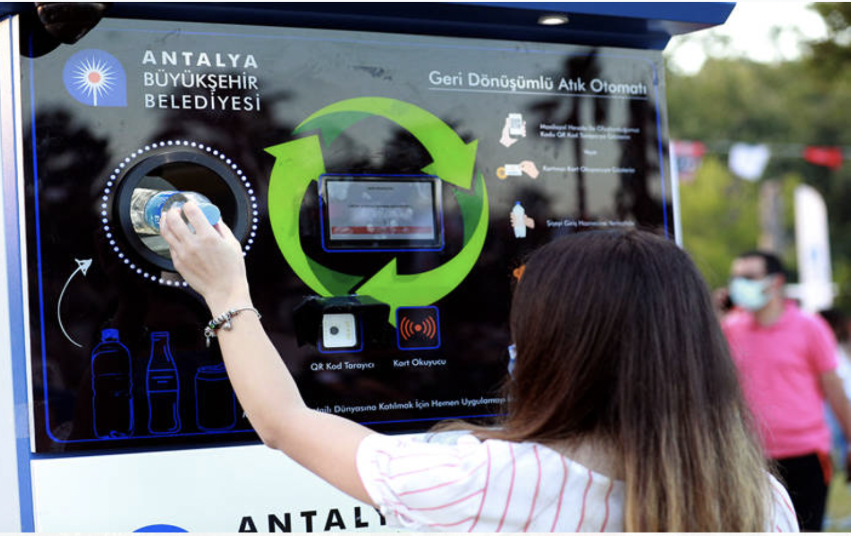
RECYCLING BOOTHS IN ANTALYA
Antalya Metropolitan Municipality has placed a recyclable waste vending machine and mask vending machine on Konyaaltı Beach. It is aimed to increase environmental awareness with vending machines
For the waste mask problem, which is the problem of the whole world due to the pandemic, Antalya Metropolitan Municipality found a solution with vending machine. In the vending machine, where the demo is made, a used mask is given and a clean mask is taken instead.
In the recyclable waste vending machine, which is another project related to waste, beverage packages are thrown into the vending machine after the barcode is scanned from the mobile phone. The vending machine charges the user's account for each waste.

Slide 3
Accordıng To Antalya Sustainable Energy Action Plan, Greenhouse Gas Reduction Is Planned.

